Slide 1
Sprint 8
Team 201

Slide 2
1.
Burndown Chart
Let’s start with a graphical representation of our progress

Slide 3
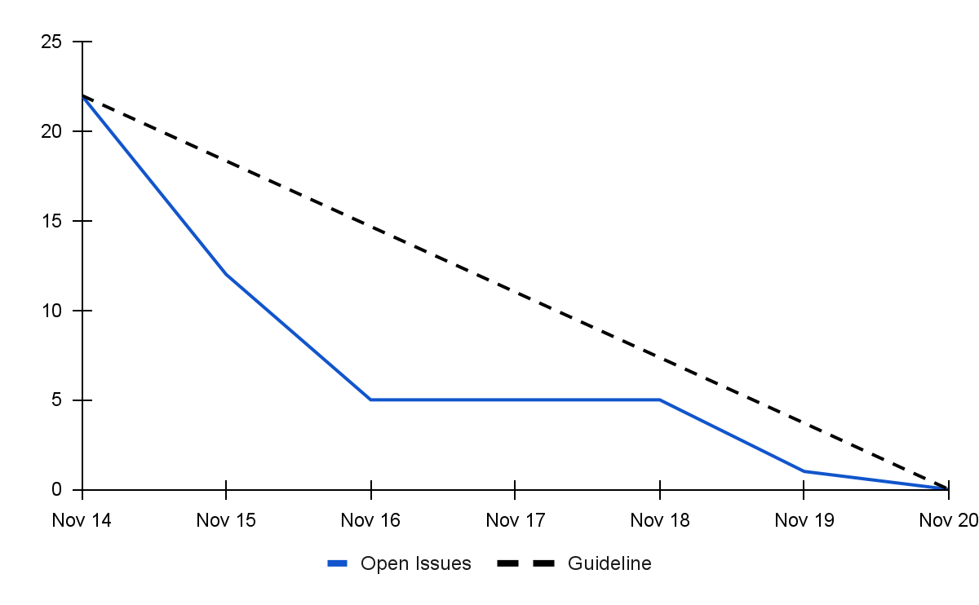
Burndown Chart

Slide 4
2.
Retrospective
Let’s review what went well and see how we can improve

Slide 5
What Went Well and Not Well
WELL
Very high sprint velocity at the beginning of the sprint
Lots of code contributions from most of the team at the beginning of the sprint
Great communication and teamwork
NOT WELL
Kanban board still not being used properly
Pipeline caused delays when runners run out of disk space

Slide 6
3.
Team Contributions
Let’s see what we worked on this sprint

Slide 7
Contributions - Ethan
Updated the parser and API to read the new W23 course data (GL159, GL160) [1h]
Improved the term selector UI and logic (GL162, GL163) [3h]
Implemented the course info modal (GL173, GL175) [4h]
Total weight: 24

Slide 8
Contributions - Nash
Created basic framework for additional features (3hr)
Created the schedule helper algorithm (10hr)
Total weight: 26pts

Slide 9
Contributions - Ameer
Set up Cypress End-to-Testing
Struggled to make it work on WSL
Wrote several front-end test using cypress
Weight: 17

Slide 10
Contributions - Sahil
Created multiple course info UI designs.
Paired with Dogu for some implementation of course info UI.
Did some code cleanup with Dogu.
Worked on adding tooltip to schedule events.
Total weight: 20

Slide 11
Contributions - Dogu
Worked on the development of Course Info section
Developed unit tests for the Course Info section
Used cypress to write various automated front end tests
Cleanup & added comments
Group meetings & Code review
Total Weight: 20

Slide 12
Contributions - Kalindu
Added tooltip for scheduled events
Frontend testing with Cypress
Code cleanup and documentation
Total weight: 15

Slide 13
Contributions - Cameron
Planning meeting
Total weight: 2

Slide 14
Demo
Time for a demo!

Slide 15
Credits
Special thanks to all the people who made and released these awesome resources for free:
Presentation template by SlidesCarnival
Photographs by Unsplash

